Slide 1
Netflix Movie Recommendation System
Combining Data Engineering and Machine Learning for Personalized Recommendations
Mariam Mahmoud
Perihan Tarek
Hanin Hossam
Hadeer Ashraf

Slide 2
Team Tasks
Name | Task
Mariam Mahmoud Hanin Hossam | Model
Perihan Tarek | Azure
Hanin Hossam Hadeer Ashraf | Database & Data WH
Hadeer Ashraf | Power BI
All team members | Report
Hadeer Ashraf Mariam Mahmoud | Presentation

Slide 3
Introduction
Develop a personalized movie recommendation system for Netflix.
Key Components:
ETL Process for Netflix data warehouse.
Machine learning model for predicting movie ratings.
Data visualization using Power BI.

Slide 4
ETL Process for Data Warehouse
Purpose:
Consolidate data for analysis and reporting.
Focus on user demographics, subscription details, and movie ratings.

Slide 5
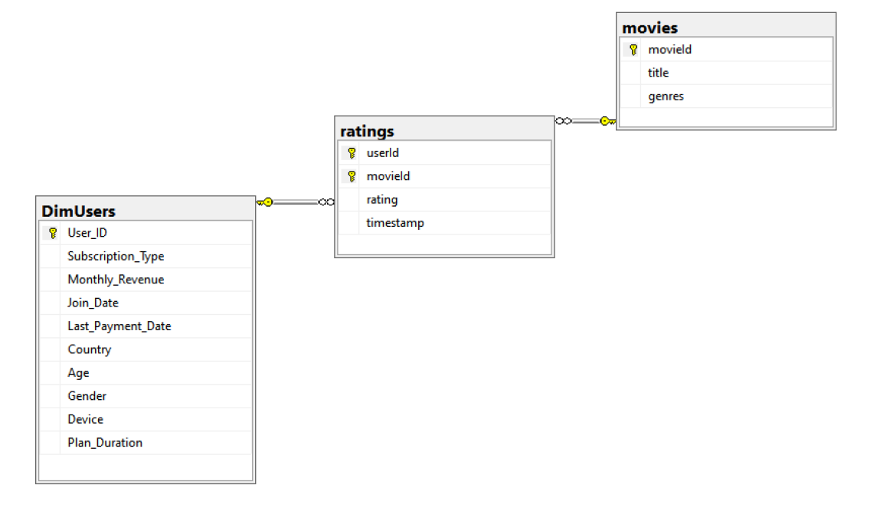
ETL Process for Data Warehouse
Schema Design:
Star Schema:
Fact table: FactRatings (movie ratings)
Dimension tables: DimUsers, DimMovies

Slide 6
ETL Process Overview
Steps Involved:
Extract: Load data from CSV files (e.g., DimUsers.csv, movies.csv, ratings.csv).
Transform: Clean, validate, and structure data.
Load: Insert data into SQL Server tables.SQL Scripts Example:
Example of BULK INSERT and constraints setup for the database.

Slide 7
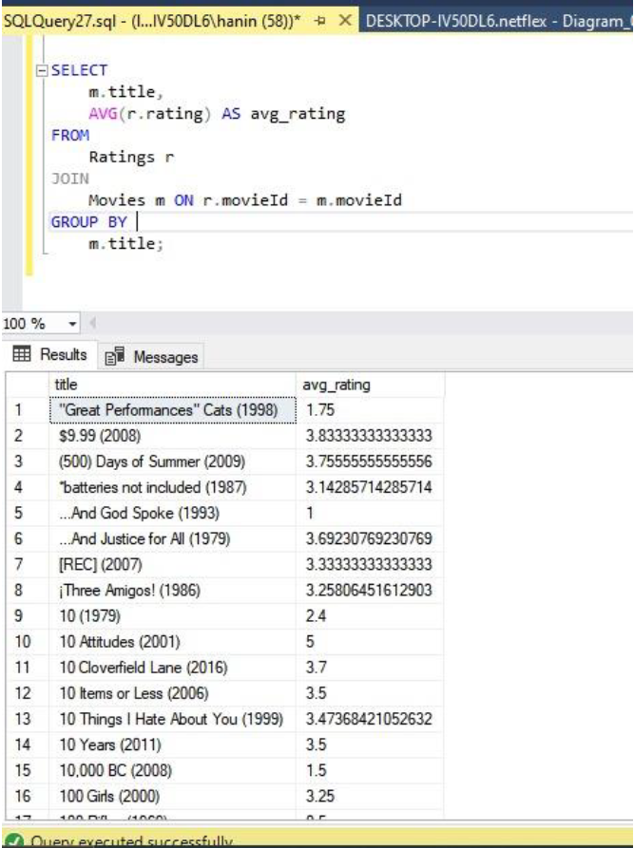
Data Warehouse Testing
SQL Query:
Retrieve average rating for each movie by joining FactRatings and DimMovies.

Slide 8
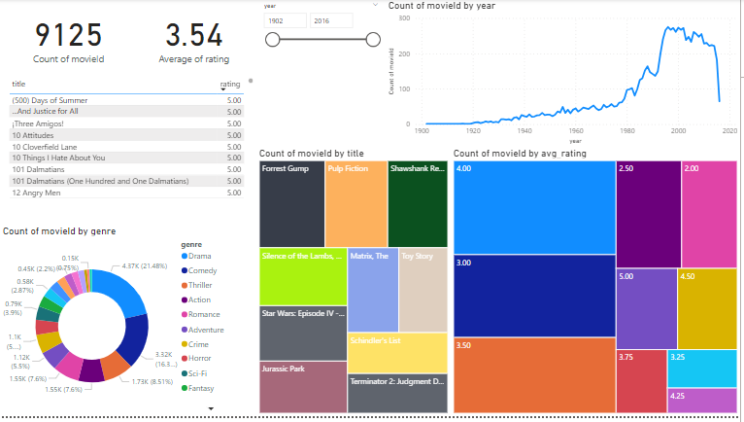
Data Visualization
Tools: Power BI
Key Insights:
Total Number of Movies Rated: 9,125
Average Rating: 3.54
Top-Rated Movies: Forrest Gump, Pulp Fiction, etc.
Genre Preferences: Drama, Comedy, Thriller lead.
Movie Production Trends: Increase in the late 20th century.

Slide 9
Machine Learning Model
Model Used: Neural Collaborative Filtering (NCF)
Components:
Embedding Layers: User and movie IDs converted to dense vectors.
Hidden Layers: Two fully connected layers with 128 and 64 neurons.
Output Layer: Predicts movie rating.Optimizer: AdamW, learning rate = 0.001.

Slide 10
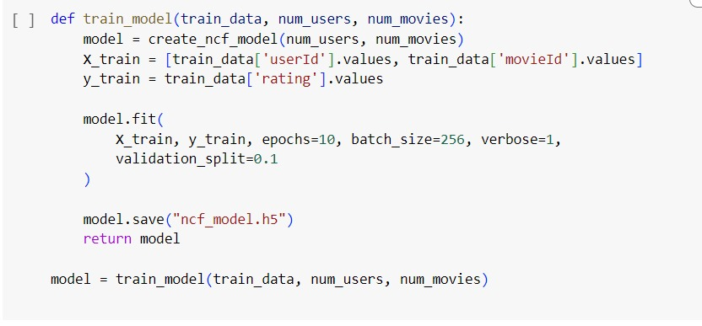
Model Training
Process:
Data split into 80% training and 20% testing.
Trained for 10 epochs with a batch size of 256.
Validation split: 10% for evaluation during training.

Slide 11
Recommendation Engine
Recommendation Process:
Filter out movies the user has rated.
Predict ratings for unrated movies.
Sort by highest ratings and recommend top N movies.
Deployed using
Gradio interface (real-time interaction).

Slide 12

Conclusion
Achievements:
Built a scalable recommendation system using ETL, machine learning, and Azure.
Data visualization provided meaningful insights into user preferences.
Machine learning model enabled personalized movie recommendations.

